Slide 1
LumiSync
FPGA-Powered Ambient Lighting for Monitors
Based on Digilent NEXYS Video Board
Group 30: Junchen Zhu — 1004900271
Nuo Si — 1005183445
Lihao Xue — 1011809875
Ruogu Xu — 1011038137

Slide 2
Table of Contents
Project Discription
Initial Goals
Implementation
Major Components
Complexity Score
Future Work
Demo

Slide 3
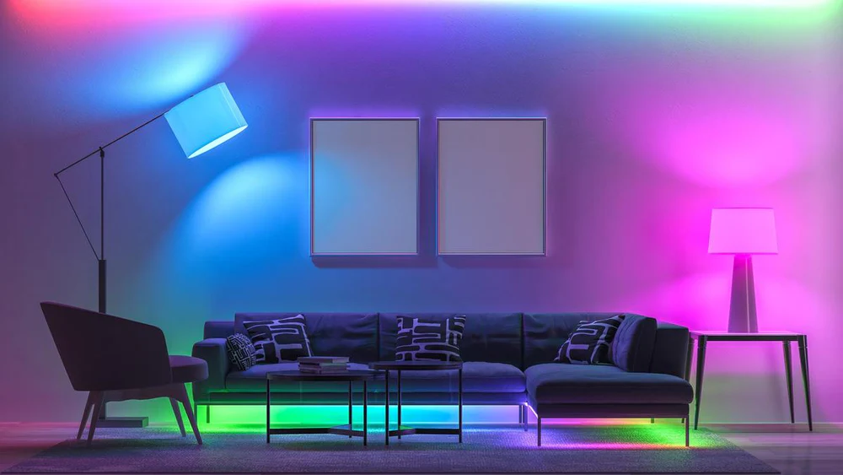
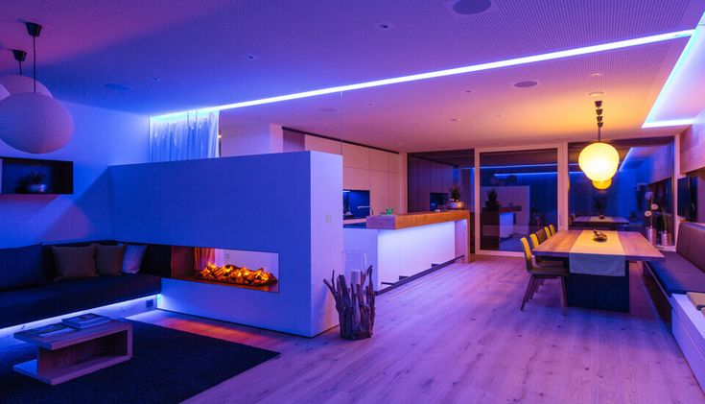
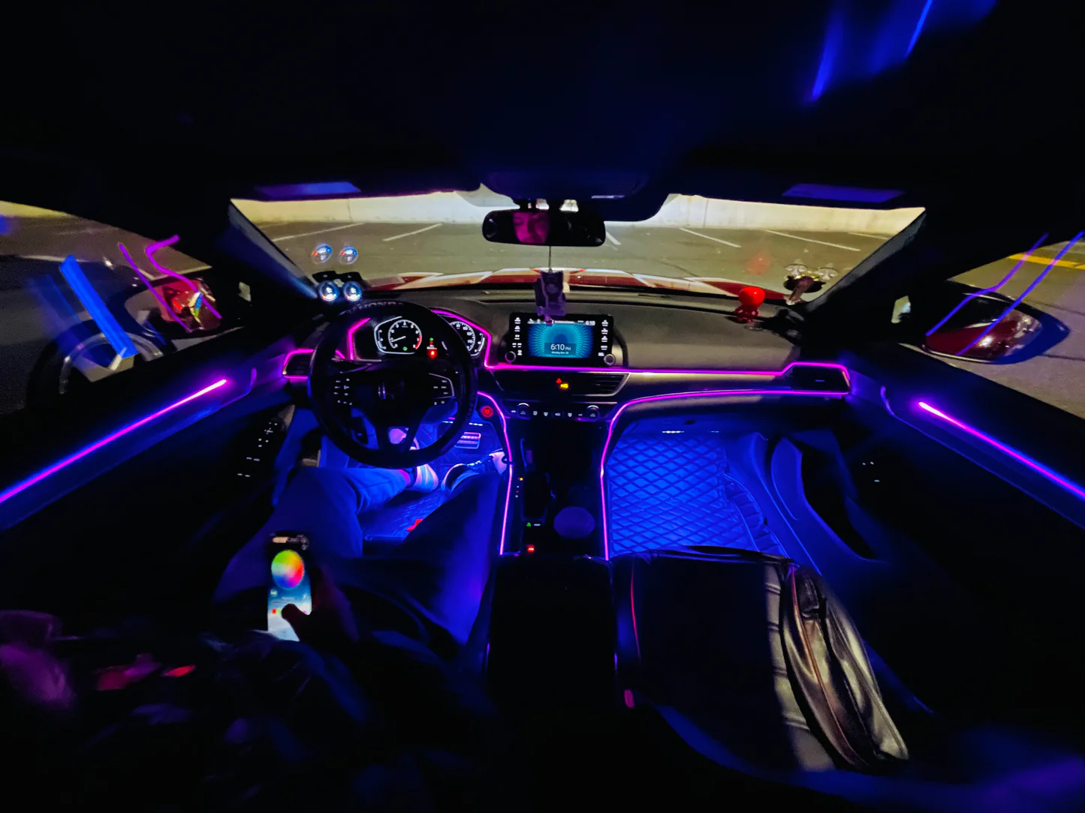
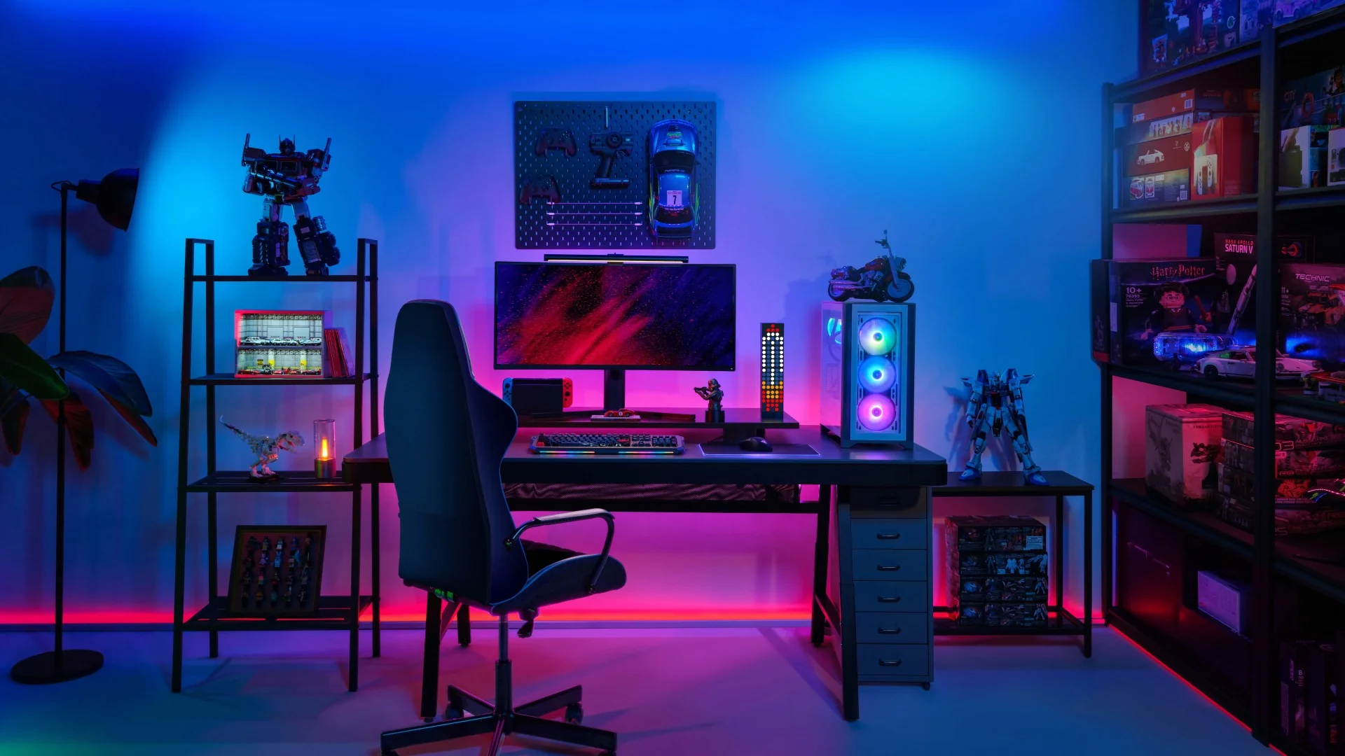
Background
Ambient lighting helps set a relaxing ambiance in homes, cars, and workspaces.
In gaming, movies, and VR, ambient lighting adapts to scenes, deepening the experience

Slide 4
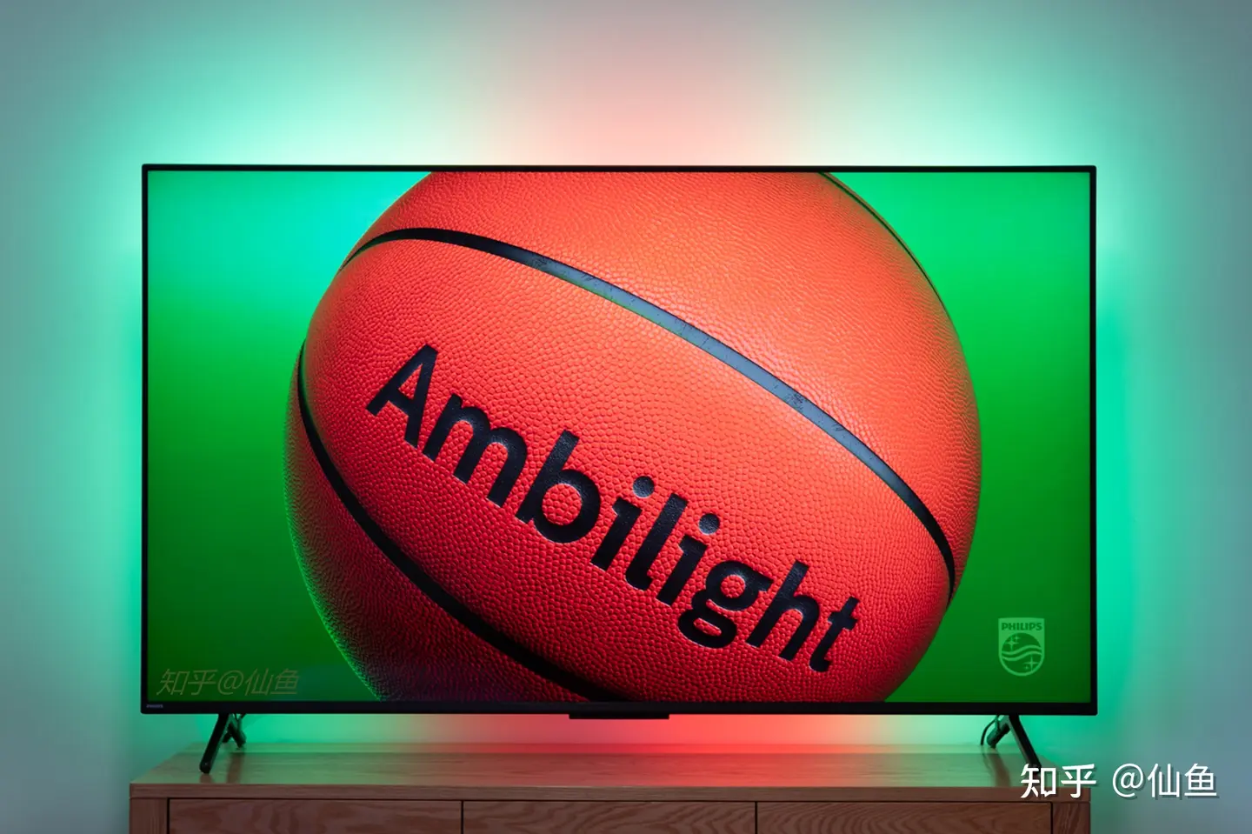
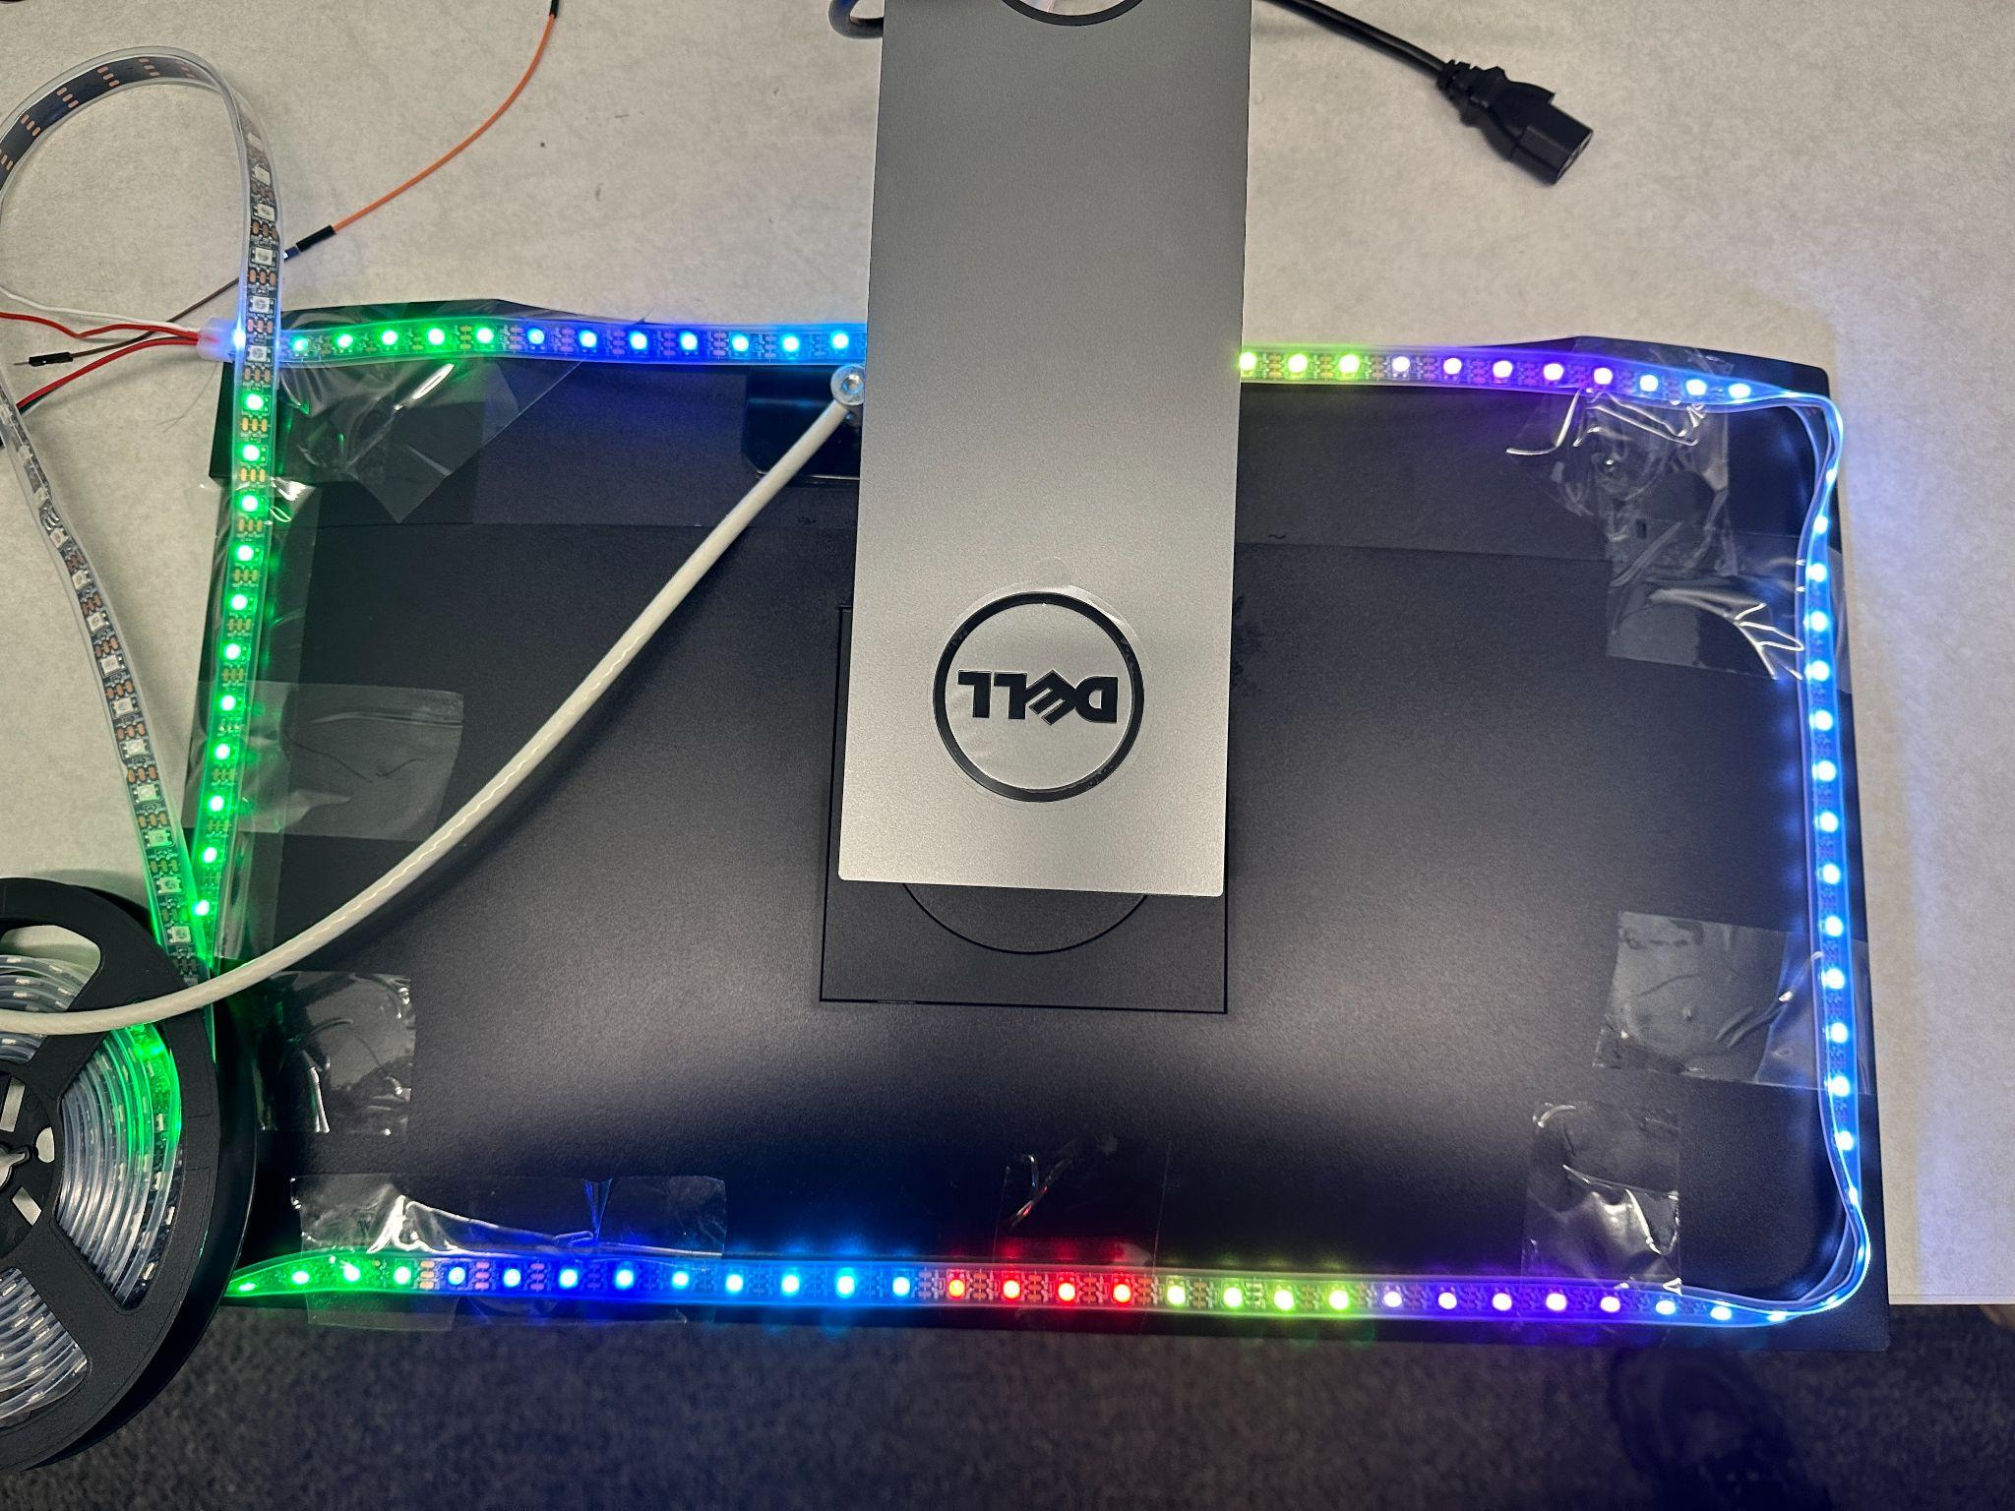
Introduction
Figure 1 shows existing product from Philips; there are also many similar products on Amazon
We are targeting monitors or any display screens
It is intelligent, showing colors corresponding to adjacent pixels on the screen
It is real-time, adapting to both image and video
Remote control through mobile app: user can choose from downloaded images & videos, stream via HDMI, or fixed patterns
Figure1: Commercial product example: Philips Ambient Light TV

Slide 5
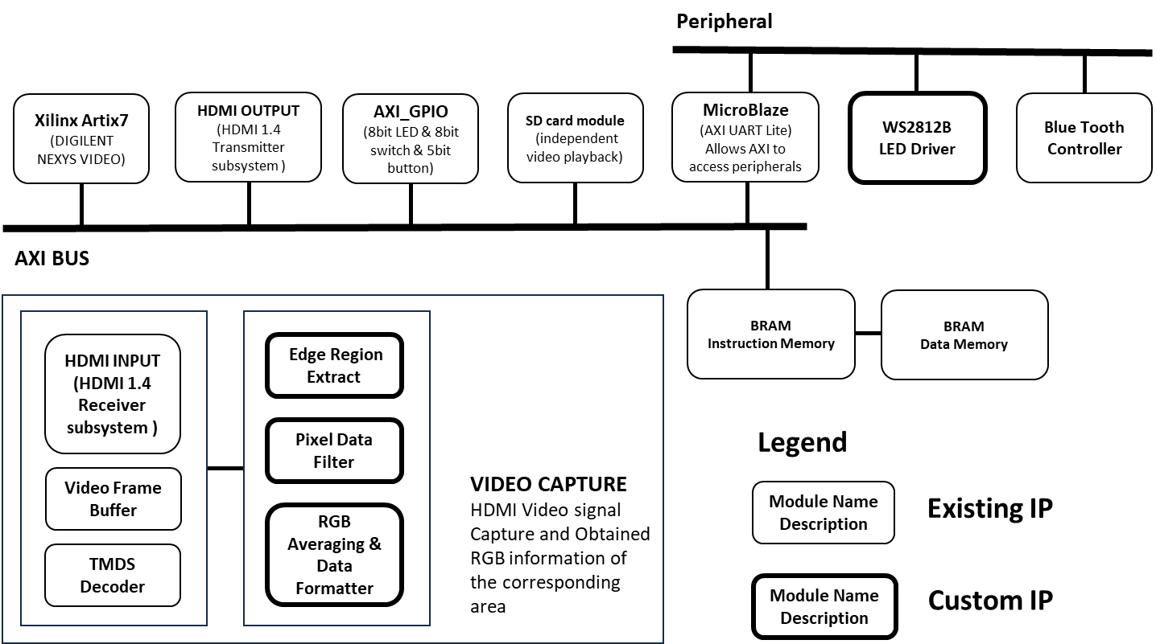
Initial Goals
Functional Requirements:
Real-time HDMI capture, decoding & RGB analysis
Sync with WS2812B LED strip for dynamic effects
Ultra-low latency via FPGA parallel processing
Multi-mode support:
Video sync
Pre-set images/videos
Custom palettes
IoT control via Bluetooth
Scalable for various display sizes
Why FPGA? MCU-based solutions rely on PC software for screen capture, leading to higher latency and performance impact. FPGA eliminates this bottleneck for a smoother experience.
Initial Project Block Diagram

Slide 6
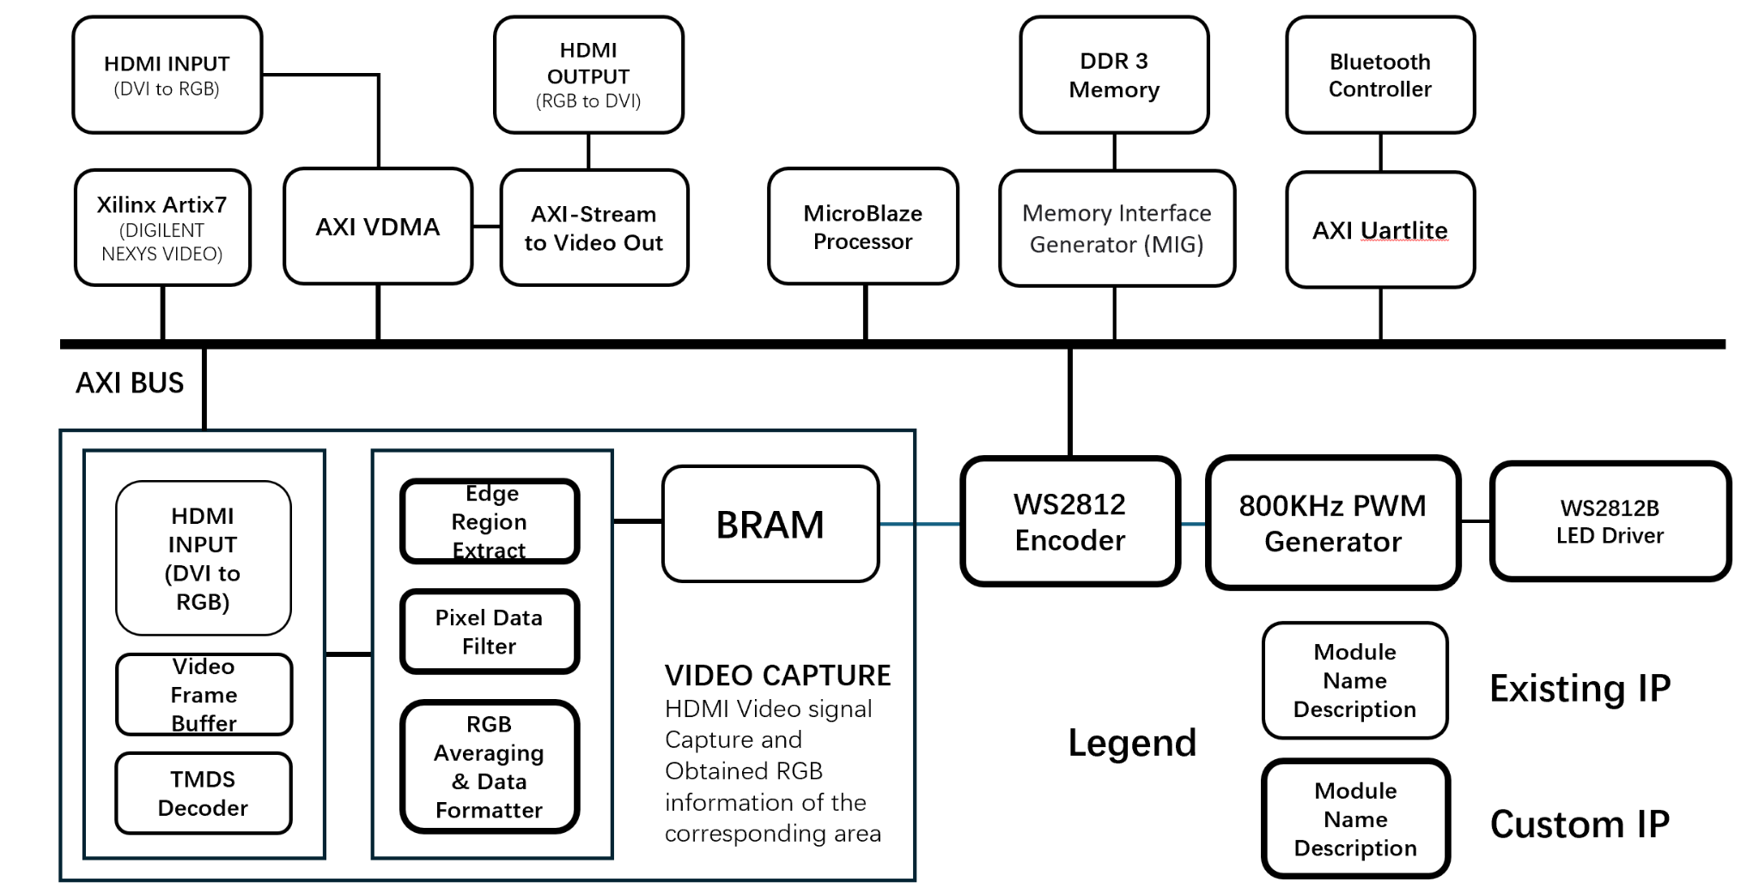
System Block Diagram
Notes:
The Ambilight system is built on the Xilinx Artix-7 (Digilent Nexys Video) platform, utilizing the AXI bus to interconnect various modules. The system first captures the HDMI video signal through the DVI2RGB IP core, converting it into an RGB888 format. A video frame buffer temporarily stores the frames. The MicroBlaze processor is used to process the video signal, such as setting the resolution and performing color inversion.
The video capture module extracts edge region data, filters pixel information, and computes the average RGB values for the corresponding regions. The processed colors are then sent to a dedicated light_strip_output IP, which generates PWM Return zero codes for the RGB LED strip driver, controlling the RGB LEDs to create ambient lighting that dynamically responds to video content.

Slide 7
Product Performance Metrics
LED Strip Update Latency Analysis
The project uses video input at 60 FPS, with a total of 98 LEDs, The density is 0.6 LEDs per centimeter.
The theoretical LED strip update latency is 19.7 ms, which includes:
16.6 ms for displaying a single video frame.
2.94 ms for LED strip communication time.
Video Partitioning and LED Update Frequency
The screen is divided into 31 × 18 = 558 video regions.
The video resolution is 1024 × 768, and the physical display size is 56 cm × 32 cm (standard 24-inch monitor).
LED strip data is updated once every 5 video frames, resulting in a theoretical LED refresh rate of 12 FPS.

Slide 8
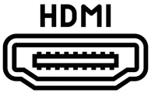

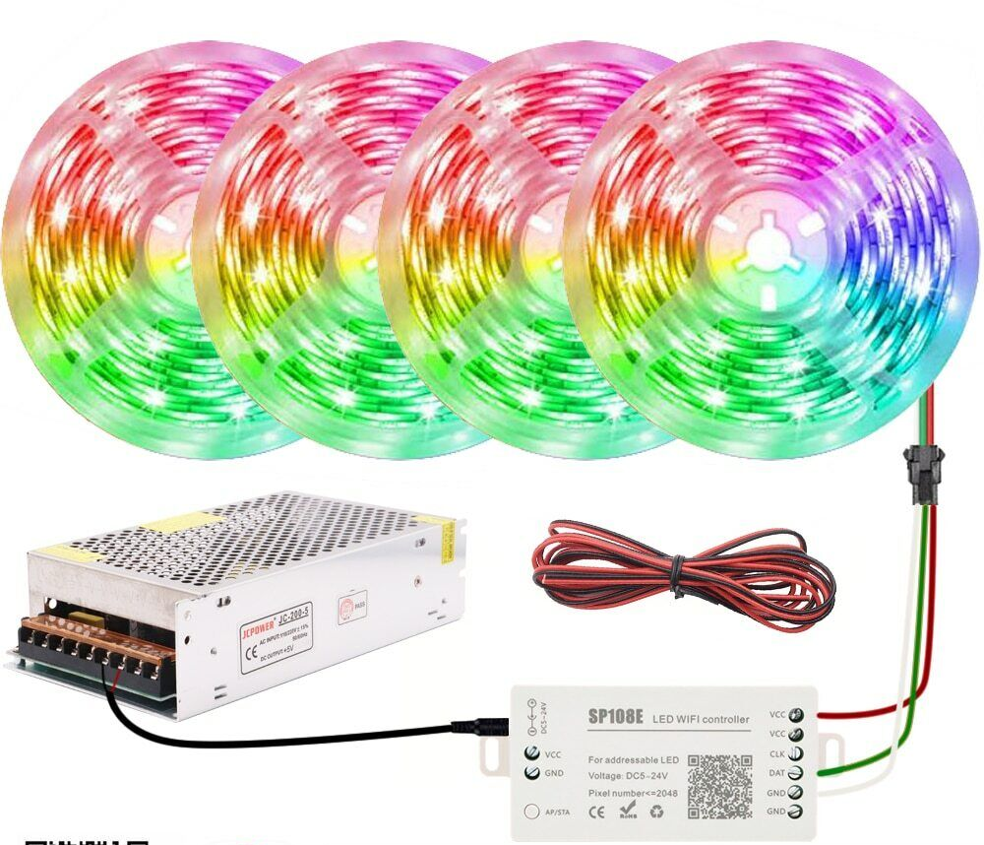
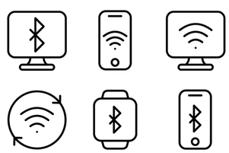
Major Components
RGB Analysis
Create an algorithm that divide the edge of the screen into multiple areas
FPGA computes the average RGB values for each region.
HDMI Signal Processing
FPGA captures, decodes, and processes HDMI input.
Transmits HDMI output to display.
WS2812B LED Strip Control
RGB data send to LED strip through a single data line.
Ensure dynamic effects with low latency.
IoT Remote Control
Integrate a Bluetooth module for mobile app control (power switch, mode).
System can be controlled remotely

Slide 9
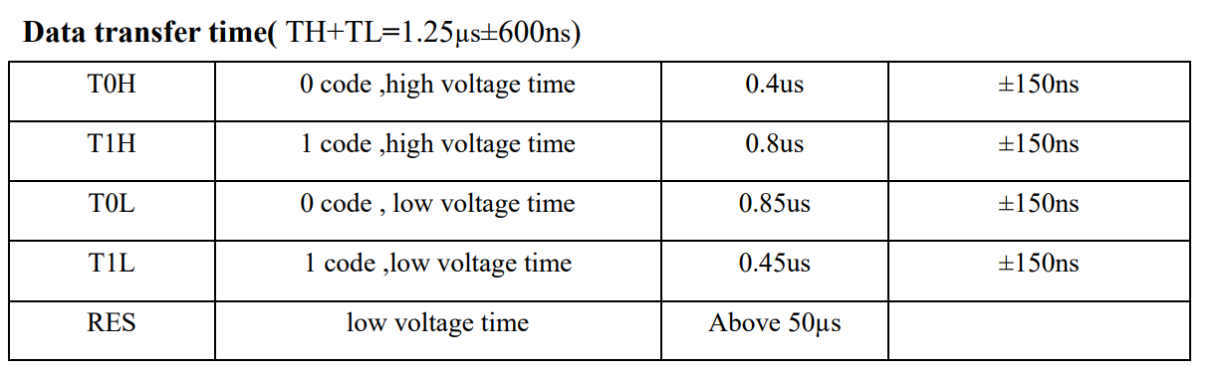
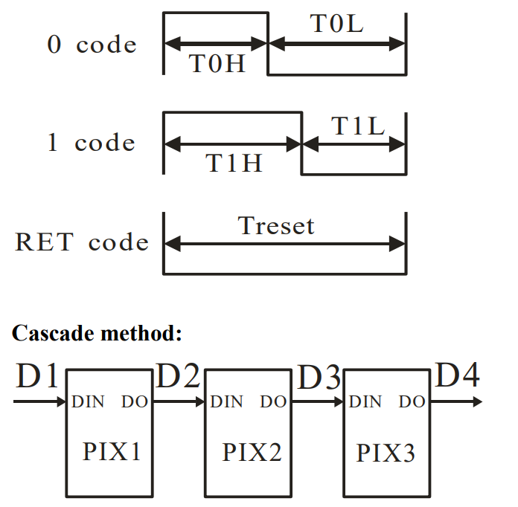
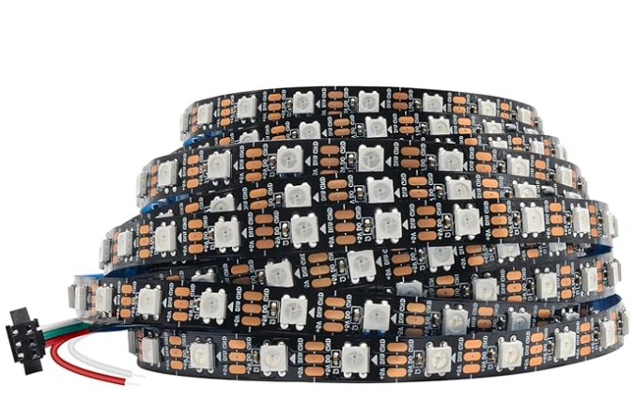
Major Components (WS2812B Light Strip)

Slide 10
Major Components (Custom IP)
RGB Analyzer - Takes video input and control signals as input, extract the edges (top, bottom, left, right) and filter the RGB data for several frames, then accumulate and average the values before storing into BRAMs. A finite state machine sequentially reads the BRAM and feeds into a FIFO for the LED Driver
LED Driver - Read from FIFO and converts 24-bit RGB data into precisely timed serial PWM signals that drives the LED strip. The WS2812B strip is sensitive to the timing, requiring 1.25us per pulse period and each LED bulb requires 24 pulses.
These are implemented purely in hardware, maximizing performance and ensuring video synchronization

Slide 11
Major Components (HDMI In & Out)
HDMI In
(DVI to RGB)
Video to AXI-Stream
AXI VDMA
AXI-Stream to Video
HDMI Out
(RGB to DVI)
AXI Interconnect
DDR3

Slide 12
Major Components (Bluetooth)
MicroBlaze
AXI Interconnect
AXI Uartlite
Bluetooth Pmod

Slide 13
Major Components (Strip Setup)
Three Inputs:
DC 5V
Data
GND

Slide 14
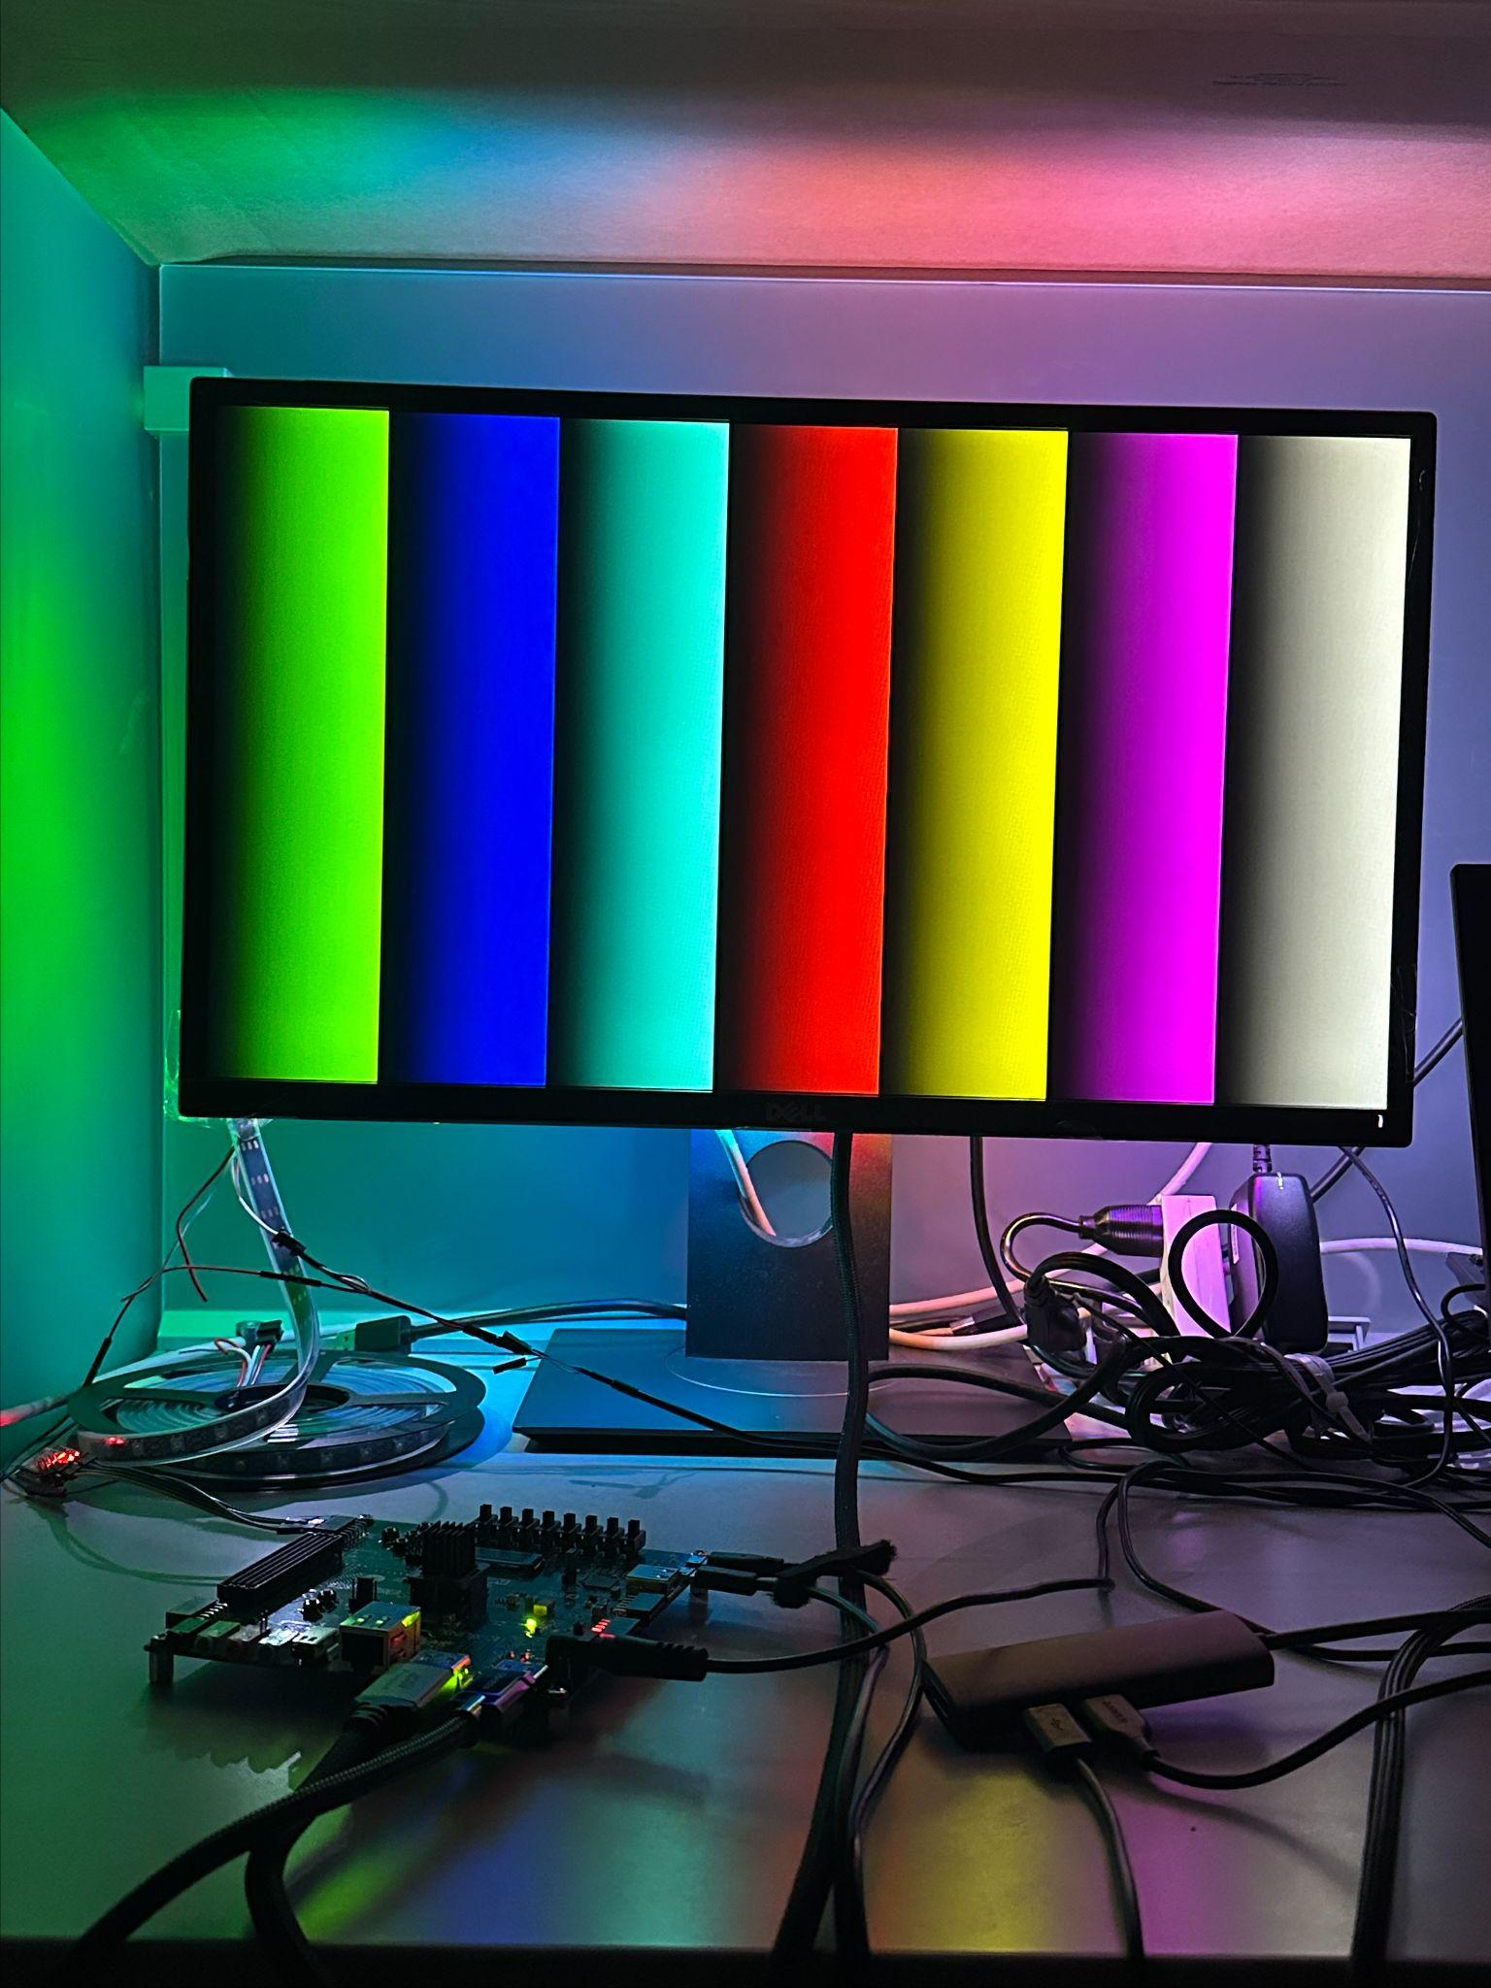
Major Components (Software)
LED Strip Demo:
An event loop listening for user commands from bluetooth
User can choose the index of the framebuffer - as pictured on the side, user select a new framebuffer and let Microblaze draw an RGB bar test, the Microblaze writes the pixel data into DRAM and waiting to be read by AXI VDMA, which then sends the data out.
User can switch LED on/off - upon pressing the power switch, Microblaze writes control signals to the Custom IP through AXI GPIO
User can change LED colors - a menu with color options is printed and when user select a color, Microblaze will write data to the LED Controller through AXI GPIO

Slide 15
Complexity Score
Components | Complexity Score
HDMI input | 1.0 point
HDMI output | 1.0 point
Custom IP | 1.5 point
Bluetooth | 1.0 point
Tri-color LEDs | 0.2 point
Software algorithm (LED demo) | 0.3 point
Total complexity Score: 5

Slide 16
Future Work & Improvements
Given more time, some improvements could be accomplished including:
Integrating SD card storage functionality - user can select HDMI source from SD card to display pre-downloaded videos & images
Add LED patterns - currently the LED strip can only display fixed RGB colors or sample from video, we could add more patterns for user to choose, this could include breathing & color wave
Add UI/UX design to our mobile App - currently the mobile App is a simple debug console and the content looks wordy, we could make it more user-friendly with UI/UX design

Slide 17
Demo

